Slide 1
Accessibility of Astronomical Publications
AAS Working Group on Accessibility and Disability
Wanda Díaz-Merced, Nicholas Murphy, Alicia Aarnio, Jacqueline Monkiewicz, Jason Nordhaus, Sarah Tuttle, & WGAD

Slide 2
Access Note:
Please use this space as you need or prefer.
Sit in chairs or on the floor, pace, lie on the floor, rock, flap, spin, move around, knit, step in and out of the room.
Feel free to use your laptop or your electronic devices or your mechanical fidget devices if you brought them. Take notes or play video games.
Meeting tag #aas231; us: @AAS_WGAD, @AliciaAarnio, @jmonkiew
Please use headphones if you use audio. -adapted from Lydia Brown, @autistichoya

Slide 3
Live feedback
Anonymous: http://bit.ly/JournalAccessAAS231
twitter.com/AAS_WGAD
Browse along: our publication recommendations are on our website (http://bit.ly/WGAD_JournalRecommendations), or feel free to take a paper copy!

Slide 4
Access and disability
WGAD approaches initiatives within a mixture of the social and nordic models of disability:
Acknowledge social and environmental barriers are major problem for disabled individuals in the field; addressing is an AAS priority
Give disabled astronomers/students agency
Allow disabled astronomers to perform/participate equally in professional community.
“incapacity to perform certain tasks” is a cultural barrier that must be challenged in our profession.
WGAD observes users to understand how we with disabilities experience barriers to our science, and how we experience our impairments in our science. This
acknowledges, respects, and validates experiences, and
contributes both quantitatively and qualitatively to the fields of astronomy and disability studies.
Notes:
this is so many words, augh

Slide 5
Universal design
Overarching theme: think about the user experience.
Universal design isn’t an abstract concept: if you’re thinking about user experience and accessibility, you’re doing it!
Things to consider:
Equitable use
Flexibility
Simplicity/intuitiveness
Perceptibility of information
Tolerance for error
Physical effort required
Size/space for use
-Center for Universal Design, NCSU
Universal design accommodates (and anticipates!) the access and cognitive needs of every human who wishes to engage. If we build it, they will come.

Slide 6
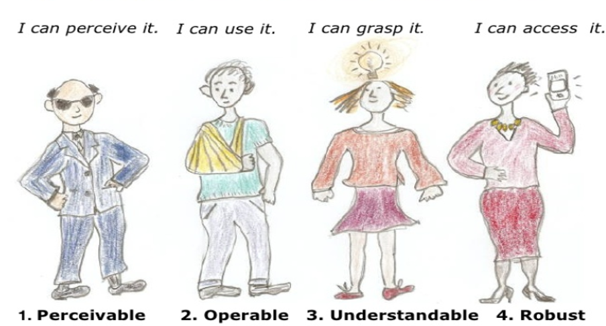
Accessibility Principles
Cartoon figures illustrate the principles:
Perceivable – Blind man with sun glasses says “I can perceive it”
Operable – Boy with arm in a sling says “I can use it”
Understandable – Girl with light bulb above her head says “I can grasp it.”
Robust – Woman holding a cell phone says “I can access it.”
Slide by Sharron Rush

Slide 7
Journal access is imperative for astronomers
Modes of access–-assistive technologies and formats
Alternative keyboards
Pointing devices
Eye-tracking equipment
Voice recognition software
Screen-reading software
de-cluttered, focused re-formatting of documents
manipulable formats
Engagement with literature is critical for
Building needed foundational knowledge
Keeping up with current state of one’s field
Being able to publish is fundamental for
Engagement with the broader professional community
Contribution to science
Assessment of one’s proficiency

Slide 8
Barriers to access discourage, isolate, and disengage.
Information retrieval
Prioritization of space-saving formats
Compact layouts problematic for cognitive, attention, and focus challenges. Accessibility > design
Accessibility/navigation of journal websites
Navigation of articles themselves
Small clickable elements necessary for full engagement
Font choices, crowding, problematic for readers with dyslexia
Information interpretation/engagement: stylistic choices
Astronomical words and phrases lacking sign language equivalents
Sensory descriptors: helpful to non-visual learners, but could be beyond sensorial perception of individuals with sensory deficits
Note, sometimes can be used in ableist ways (e.g., any analogy that equates a sensory disability with ignorance or not knowing something)
Notes:
General overview before we start going table by table

Slide 9
Think of 2 ways to address each barrier: one that journals can do, one that authors can do
Disability | Barrier(s)
Blindness: no vision | Compatibility of content (e.g., file formats, math markup) with assistive technology Accessing certain forms of data (tables, plots, etc) Reliance on memory to navigate, make sense of, retain information
Low vision: no peripheral vision, difficulty detecting parallax, motion | Need to be able to magnify content to perceive it
Colorblindness: cannot perceive differences between certain colors (red/green most common form) | Chosen palettes render some graphics inscrutable; collapse a dimension of additional information
Motor impairment: difficulty using keyboard or mouse | Small, clickable elements required for selecting, highlighting, entering content
Dyslexia: difficulty distinguishing letters in many standard fonts, including most italics; transposes letters, words, numbers | Difficulty, sometimes to point of dizziness/nausea when attempting to read certain fonts
Cognitive impairment after stroke, depression, or other illness | Difficulty with focus, executive function, working memory
Notes:
Break-out discussion. We showed the left column briefly to illustrate that every row illustrates people, astronomers, real and identifying as having those disabilities; then we covered the left column to focus on what the barriers are.

Slide 10
Recommendations-- Journals
Form committee to evaluate present state of accessibility relative to current guidelines for web, PDF
User-centered focus studies to assess needs, what current barriers may be, and to anticipate how innovations can meet future needs
Perform regular usability evaluations, seek community feedback
Provide authors with guidelines on accessibility for their manuscripts; ask referees to comment on a paper’s accessibility
Assess basic accessibility (e.g., HTML accessibility checks, OCR PDFs)
Use screen-reader compatible math markup language
Ensure article format allows Braille embossing
Provide multiple, manipulable file formats users can customize to their needs ---> example: http://www.mdpi.com/2075-4434/5/4/56

Slide 11
Recommendations-- Authors
Clearly organize and structure content in manuscripts
Write for an audience ranging from students/early-career astronomers to the most senior
Use sensorial descriptors, and with care (OAD currently researching this)
Check that figures use colorblind intuitive palettes
Provide sufficient description in figure captions; future: audio accompaniment
Data from figures and tables should be in a format readily able to be sonification
Notes:
(switch to xSonify demo after this)

Slide 12
Thank you!
Future work
Useful access tools
Contact us if you’d be willing to test/give feedback!
wgad.aas.org/contact
bit.ly/JournalAccessAAS231
In development:
database access
new article formats (e.g., ePub3)
new visualization tools
can shape recommendations as they’re being developed
VoiceOver on your phone
ColorOracle
xSonify
Website for checking other sites’ W3C compliance: wave.webaim.org
When in doubt: make it flexible, make it multimodal
Copies of this and other WGAD presentations available on our website, as well as links to resources demonstrated here

